Slide 1
Authentication & Authorization in Microservices

Slide 2
Authentication: Refers to verify who you are, so you need to use username and password for authentication.
Authorization: Refers to what you can do, for example access, edit or delete permissions to some documents, and this happens after verification passes.
Notes:
Bill

Slide 3
In a monolithic architecture, security is managed by the application server. Since all the services are deployed on one application server and there is a centralized authentication service which uses the session management features of the application server. Once a user logs in, a session is maintained and it's not necessary for all services to authenticate the user.
But in a microservice architecture, authentication/authorization becomes more challenging. Since each microservice may be deployed remotely (and not locally) and all communication happening mostly through HTTP calls, it is not clear how to authenticate the user and pass that information to all microservices.
Notes:
Bill

Slide 4
Monolithic app authentication and authorization Strategies
Form Based Login
Basic Auth
Single sign-on
LDAP
Notes:
Bill

Slide 5
Microservices authentication and authorization Strategies
Distributed Session Management
Sticky session
Session replication
Centralized session storage
Client Token
Single sign-on
Client Token with API Gateway
Third-party application access
API Token
OAuth
Notes:
Bill

Slide 6
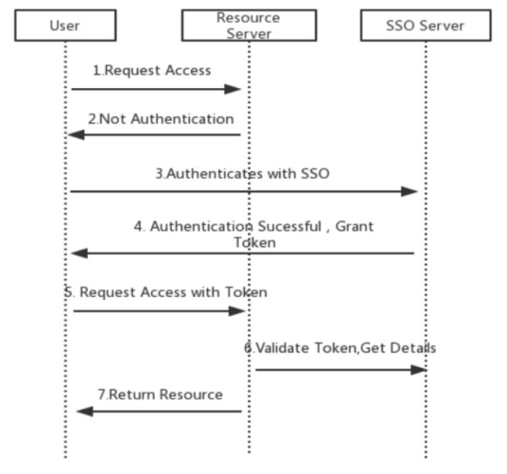
Single Sign-On
Notes:
Bill

Slide 7
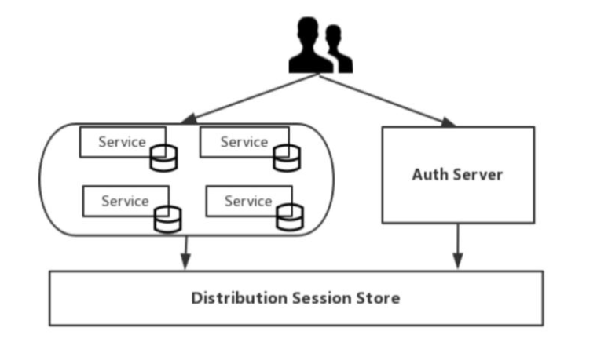
Distributed Session Store
Notes:
Bill

Slide 8
MONOLITHIC APPLICATION AUTHENTICATION AND AUTHORIZATON
Notes:
Bill

Slide 9
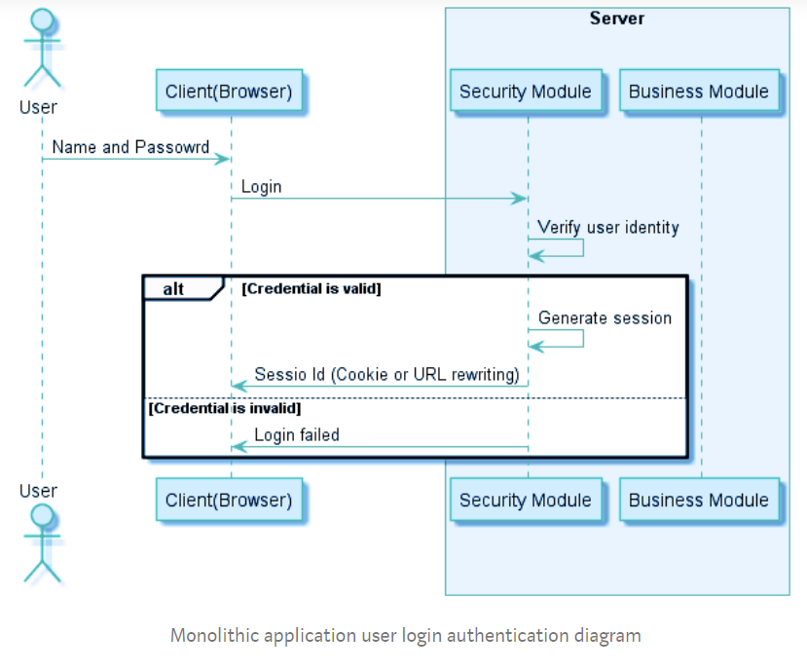
HOW IT WORKS
Notes:
Bill

Slide 10
When the user logs in, the security module of the application authenticates the identity of the user. After verifying that the user is legitimate, a session is created for the user, and a unique session ID is associated with the session. A session stores login user information such as User name, Role, and Permission. The server returns the Session Id to the client. The client records the Session Id as a cookie and sends it to the application in subsequent requests. The application can then use the Session Id to verify the user’s identity, without having to enter a user name and password for authentication each time.
Notes:
Bill

Slide 11
When the client accesses the application, Session Id is sent to the application along with the HTTP request. The security module generally processes all received client requests through an authorization interceptor. This interceptor first determines whether the Session Id exists. If the Session Id exists, it knows that the user has logged in. Then, by querying the user rights, it is determined whether the user can execute the request or not
Notes:
Bill

Slide 12
MICROSERVICES AUTHENTICATION AND AUTHORIZATON USING JWT
Notes:
Bill

Slide 13
JWT AUTHENTICATION
One of the primary use cases of using JWTs is to authenticate requests. Once a user is logged in, each subsequent request can include the JWT to access previously inaccessible protected resources and services.
Following are the parties involved
Resource Owner (the User)
Resource Server
Authorization Server
Client
Notes:
Bill

Slide 14
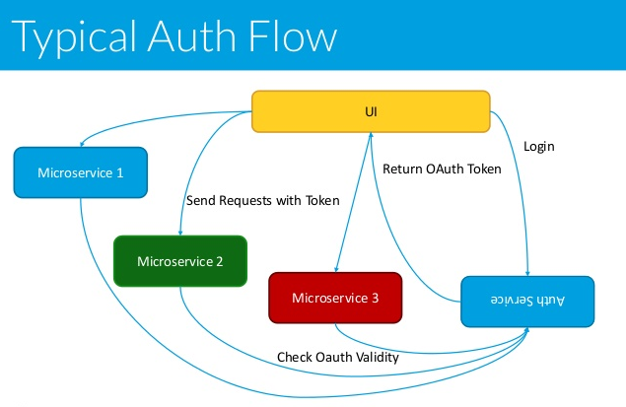
HOW IT WORKS
Notes:
Bill

Slide 15
JWT and Stateless Authentications
JSON Web Tokens (JWT) are an open industry standard method for representing claims securely between two parties. It exists in the form of either JWS (JSON Web Signature) or JWE (JSON Web Encryption). JWS and JWE are concrete implementations of JWT - which is like an abstract class. It's a way to implement stateless authentication, that's when you don't need to persist the state of authenticated users (sessions) in any data store.
Using JWT, the session state is persisted as part of the token and you can also persist other relevant data to not only authenticate, but authorize API consumers as well. That means you don’t’ need to retrieve this data in a database making your service faster and consuming less computational resources.
Notes:
Bill

Slide 16
JWT and Stateless Authentications
JWT is a useful standard because it sends information that can be verified and trusted with a digital signature. JWTs allow you to sign information (referred to as claims) with a signature and can be verified at a later time with a secret signing key. The spec is also designed with more advanced features that help against man-in-the-middle and replay attacks.
The most important thing about JSON Web Tokens is that they are signed. This ensures the claims have not been tampered with when stored and passed between your service and another service. This is called verifying the signature. JWT has more advanced features for encryption, so if you need the information in the claims to be encrypted, this is possible using JSON Web Encryption.
Notes:
Bill

Slide 17
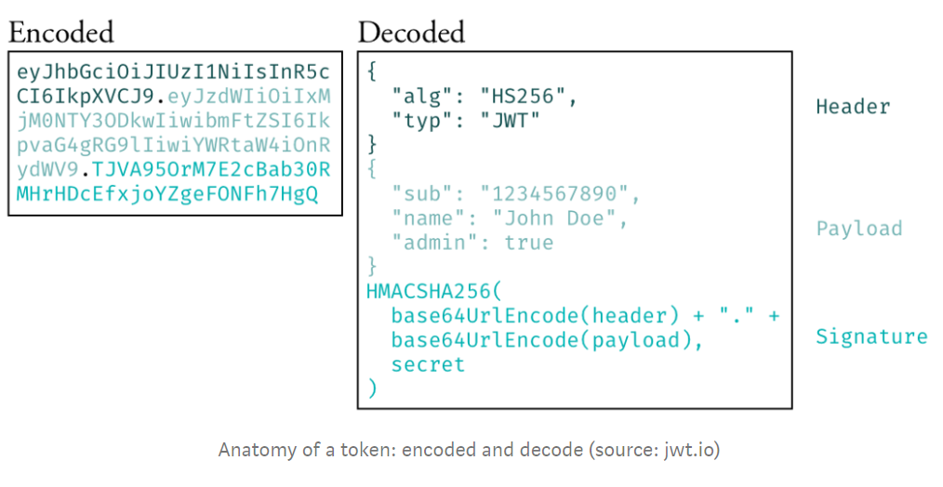
JWT and Stateless Authentications
A JSON Web Token (JWT)
Notes:
Bill

Slide 18
JWT and Stateless Authentications
A JWT is a JSON string encrypted with a secret key.
This string is also encoded using base64.
One token represents a user session.
This token is part of each request (Header) from one API to another, like in Basic Auth.
Notes:
Bill

Slide 19
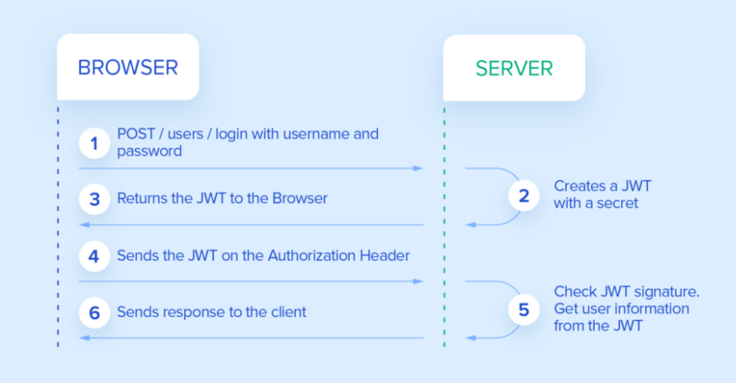
HOW IT WORKS
Notes:
Bill

Slide 20
JWT and Stateless Authentications
When a request is made by the client, it first communicates with the Authorization server and gets an access-token. The request along with the access-token is sent to the API Gateway. At this point, access-token is decrypted and send back to the Authorization server to get the JWT (after validation). The JWT token contains the user identity along with the microservices. Each microservice validates the JWT and generates its own JWT to communicates with other microservices according to scope rules. This is possible only if we have the mechanism to decrypt these JWT tokens at each microservice. Sometimes nested JWT is also used in which previous JWT is sent along with the new JWT.
Notes:
Bill

Slide 21
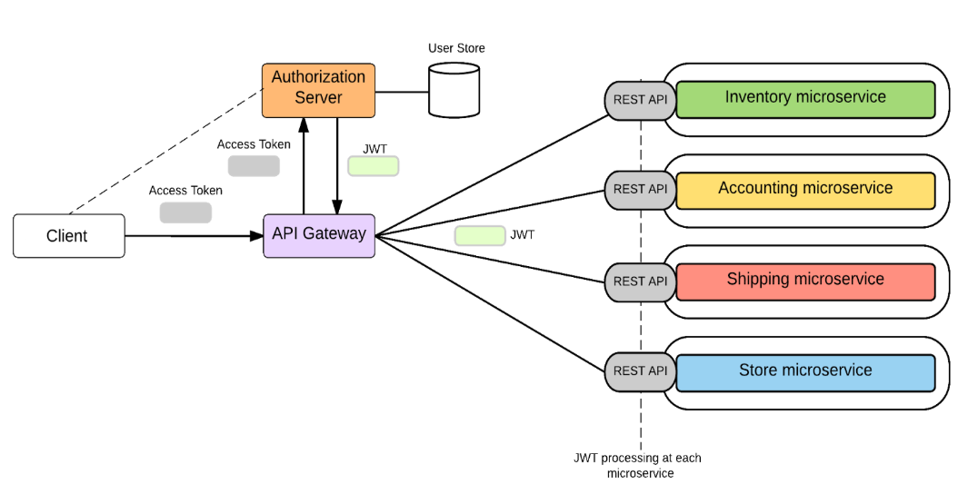
Notes:
Bill

Slide 22
Q & A
Notes:
Bill

